Slide 2
Rethinking landscapes in a changing climate An experiment from Spain Irene Bianchi Department of Architecture and Urban Studies Politecnico di Milano With: M. Vitaller Del Olmo, A. De Götzen, N. Morelli (AAU) G. Concilio (DAStU - POLIMI)
New Metropolitan Perspectives 2024
Reggio Calabria, 22nd May 2024
S03: Collaborative Governance, Planning Policies,
and social-ecological innovations
towards Climate mitigation and Urban biodiversity

Slide 3
PALIMPSEST explores creative action for landscape sustainability transition
through co-creation experiments
I. Bianchi
NMP24
Reggio Calabria, 22/05/2024
Notes:
This transdiciplinary composition is relevant, as …
co-production in 3 pilot landscapes

Slide 4
The starting point
Landscapes as
living and dynamic manifestations
of stratified nature-human interactions
(Corboz, 1983; Secchi 1998)
privileged foci for the observation of
misalignments, tensions and contradictions
as the one brough by CC, but also by CCA strategies and policies
Photo: I. Bianchi
April 2024
I. Bianchi
NMP24
Reggio Calabria, 22/05/2024

Slide 5
The question
creative action as a sustainability transition driver?
Creative action and thinking might
provide alternative ways of framing and understanding (Sacco, 2023)
imagine unexplored possibilities
give voice to multiple agencies and create room for new alliances (Metta, 2023)
give space to the intangible/invisible dimension (Jakob, 2023)
interact with practices and behaviours
I. Bianchi
NMP24
Reggio Calabria, 22/05/2024

Slide 6
The methodology | A co-creation approach
2 cycles
PILOTS
ACTIVATION
What challenges?
What future?
CREATIVE DIALOGUES
Connecting creative agents with landscape challenges and practices
RESIDENTIAL WORKSHOPS
Idea development
Prototype planning
PROTOTYPING
Elaborating on ideas in context
TESTING
Experimenting with prototypes
LANDSCAPE SERVICES AND SCENARIOS
LANDSCAPE
CHALLENGES
CALL
I. Bianchi
NMP24
Reggio Calabria, 22/05/2024

Slide 7
The actors
LOCAL CULTURAL ACTORS
HOW CAN CREATIVE PRACTICES HYBRIDISE WITH PROFESSIONAL ACTIONS AND DIALOGUE WITH PLACE-SPECIFIC NEEDS?
local network activation
LOCAL COMMUNITIES AND STAKEHOLDERS
POLICY-
MAKERS
LOCAL ART CURATOR
INTERNATIONAL ARTISTS, DESIGNER, LANDSCAPE PROFESSIONALS
SCIENTISTS & RESEARCHERS
partners & advisory board
I. Bianchi
NMP24
Reggio Calabria, 22/05/2024
Notes:
How to generate practices to enhance the capacity of territories - and landscapes that become visible in them - to respond contemporary climate and environmental crises?
How to open spaces for landscape architects, designers and artists to work together with scientists, local institutions and communities?
How can architecture, design and art allow accessing reality from a different perspective, and gain a value generative role in the making of future landscapes?

Slide 8
The methodology | A co-creation approach
2 cycles
PILOTS
ACTIVATION
What
challenges?
What future?
CREATIVE DIALOGUES
Connecting creative agents with landscape challenges and practices
RESIDENTIAL WORKSHOPS
Idea development
Prototype planning
PROTOTYPING
Elaborating on ideas in context
TESTING
Experimenting with prototypes
LANDSCAPE SERVICES AND SCENARIOS
LANDSCAPE
CHALLENGES
CALL
04-07/23
07-09/23
09-12/23
04/24
I. Bianchi
NMP24
Reggio Calabria, 22/05/2024

Slide 9
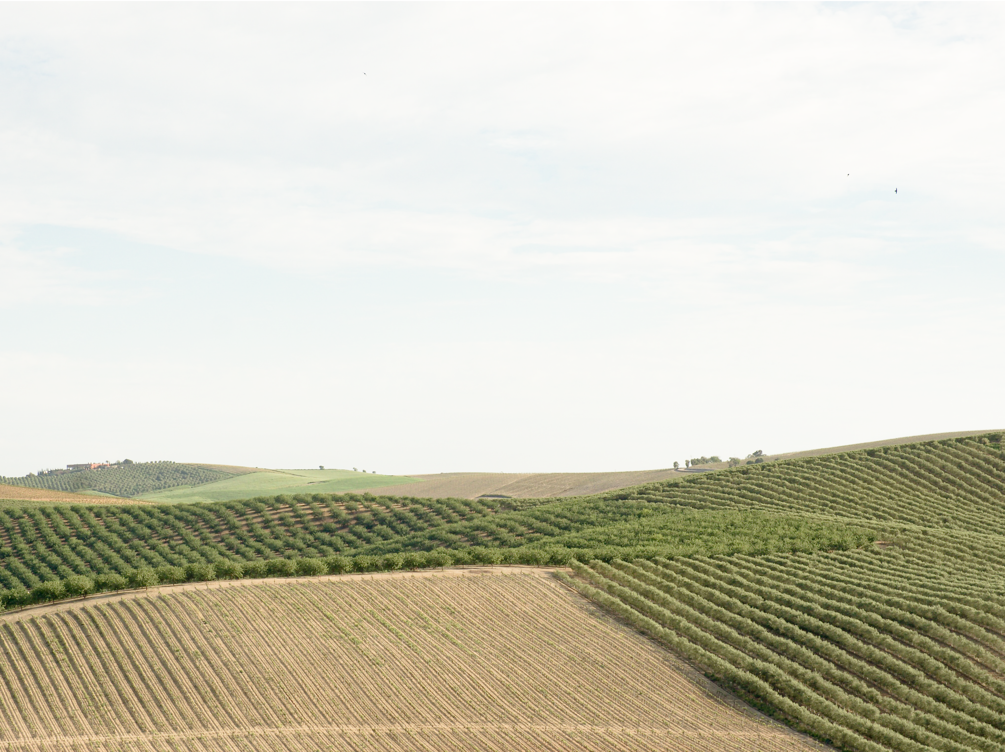
Jerez de La Frontera
a wine landscape
challenged
by CC effects
Photo: I. Bianchi
April 2024

Slide 10
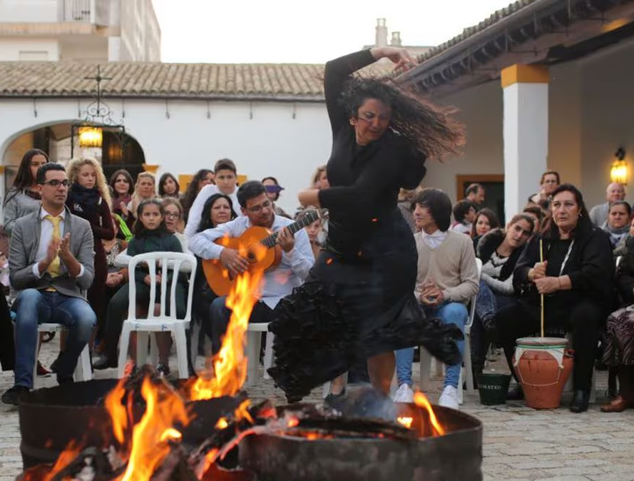
Jerez de La Frontera
Jerez de La Frontera
a wine landscape
challenged
by CC effects
the birthplace of
Flamenco
Photo: I. Bianchi
April 2024
Photo
J. C. Toro

Slide 11
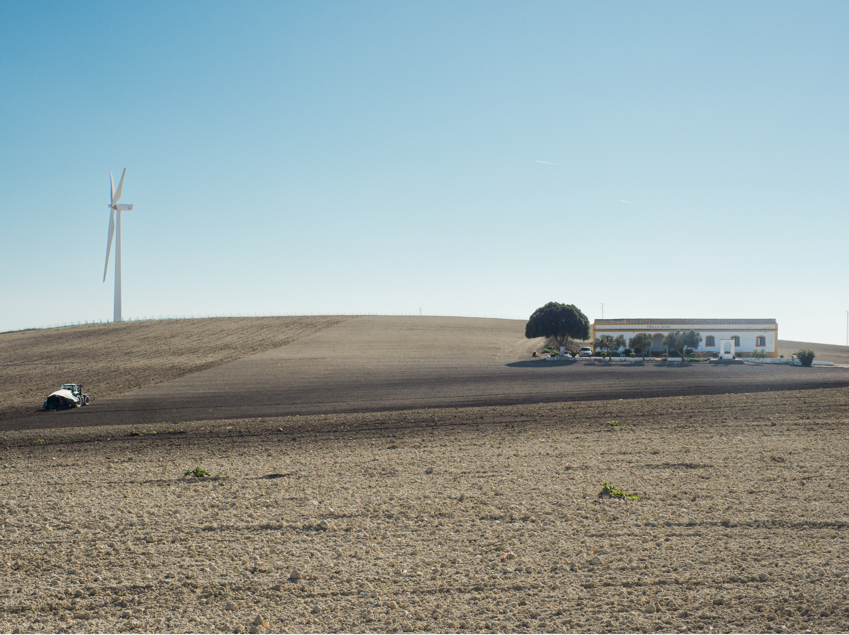
Jerez de La Frontera
a wine landscape
challenged
by CC effects
the birthplace of
Flamenco
a new energy
landscape?
Photo: I. Bianchi
February 2024

Slide 12
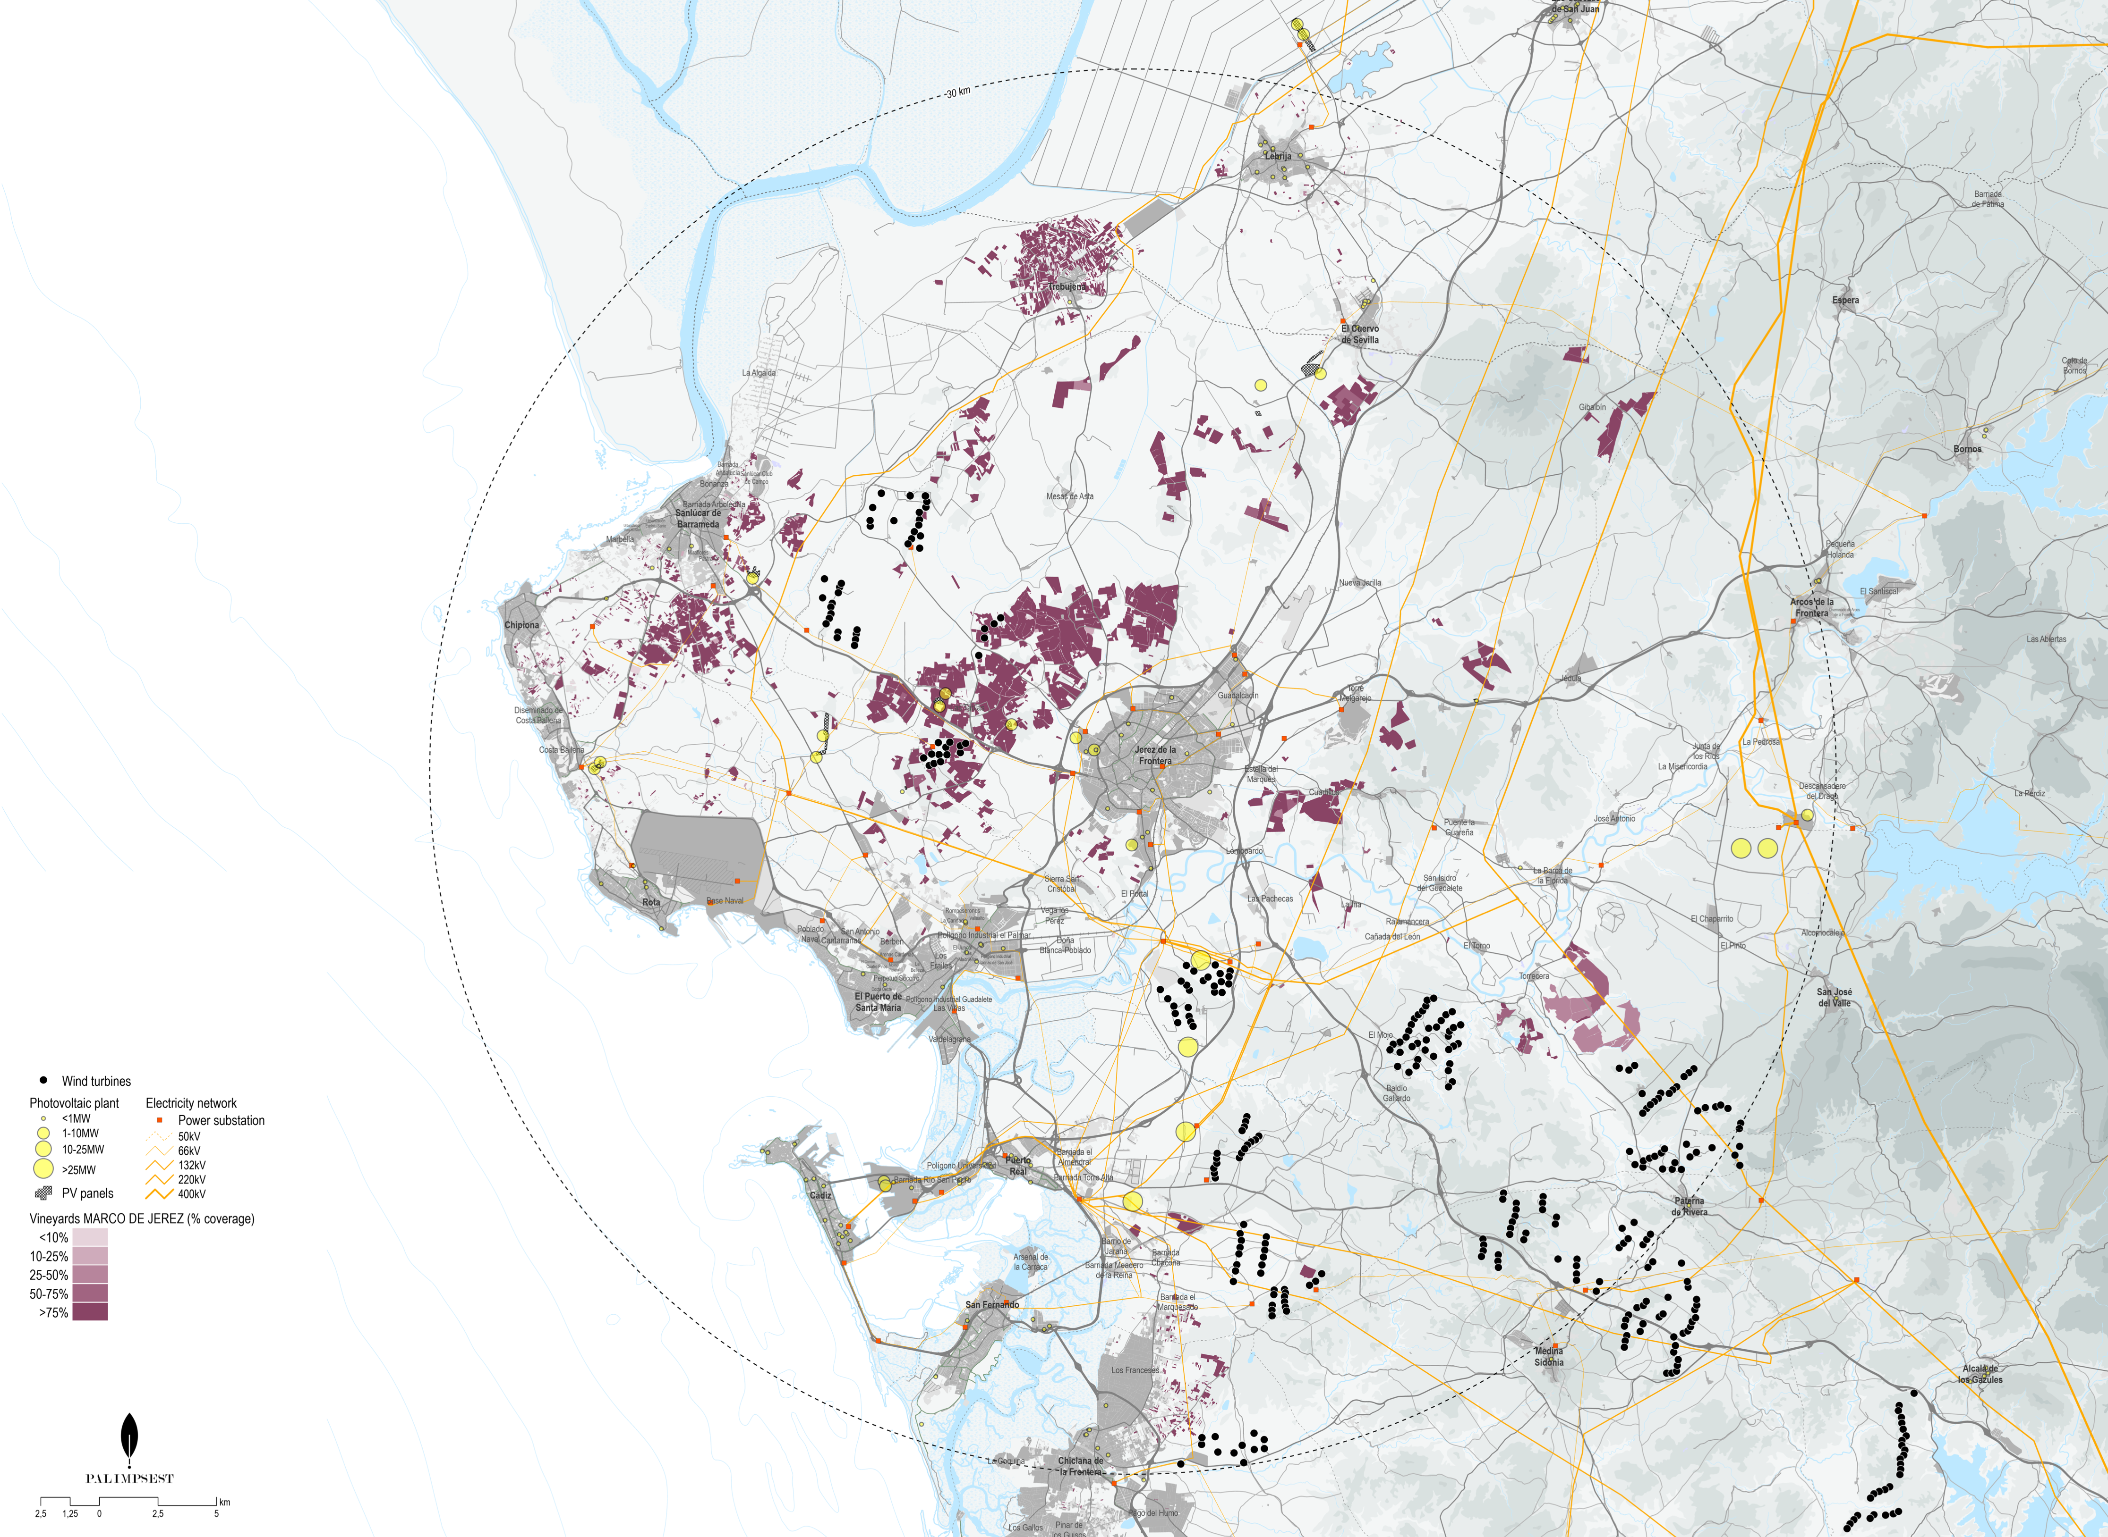
A new energy landscape?
Photo: I. Bianchi
April 2024
Source: F. Pazons
Nomad Garden
2024

Slide 13
The experiment | Pilot activation
Understanding practices
shaping the landscape in change
Connecting with local actors
Identifying conflictual dimensions
Typology | Practices | Relation with the landscape
Fruition | Tabancos, mostos, ferias, romerías, zambombas, tourism, flamenco | Cultural heritage & local identity
Production | Viticulture, agriculture, transhumance, energy | Cultural heritage, permanence/modification of landscape dynamics
Conservation | Biodiversity protection, protection of bird migration routes, local stewardship | Maintenance of environmental resources and ecological functions
Management & Planning | Funds allocation, compensation practices, land-use regulations, stakeholder engagement | Orientation of landscape transformation processes; Definition of modes of interaction
I. Bianchi
NMP24
Reggio Calabria, 22/05/2024

Slide 14
A new energy landscape?
Conflictual dimensions
Planning | Land use and planning mechanisms
Governance | Competences and interests across sectors and scales
Discourses | Policy priorities and rationales
Imaginaries | Visions of the future
I. Bianchi
NMP24
Reggio Calabria, 22/05/2024

Slide 15
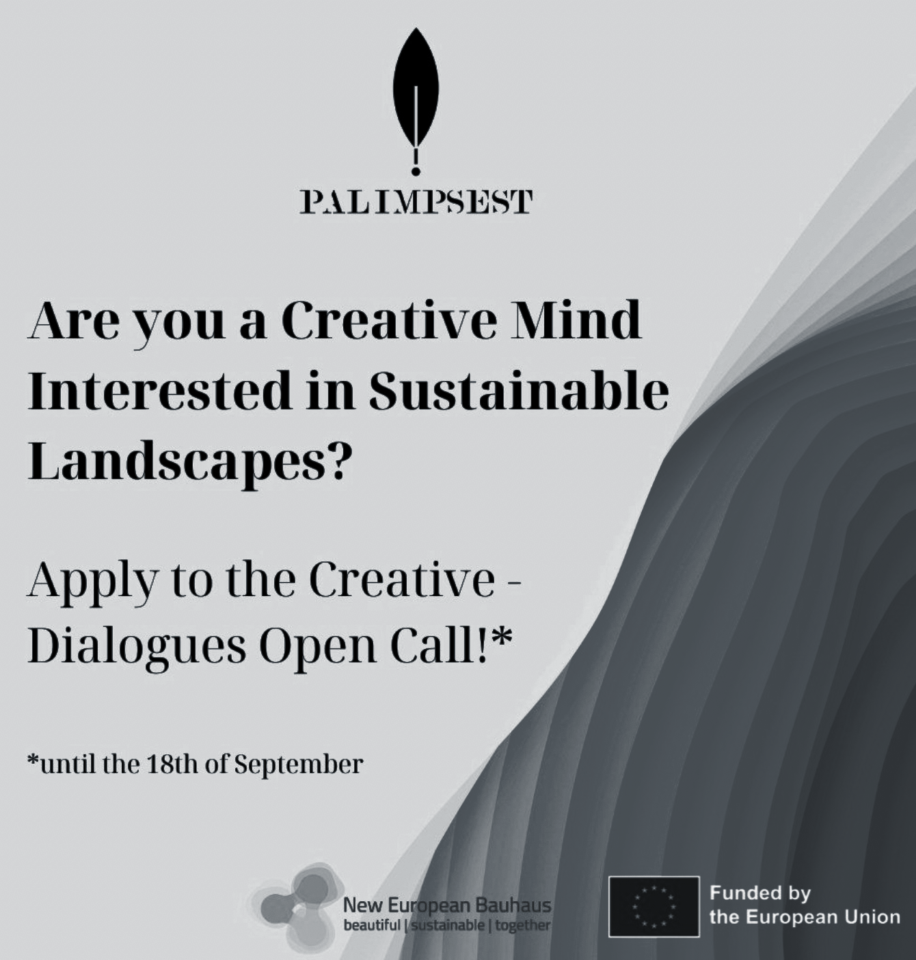
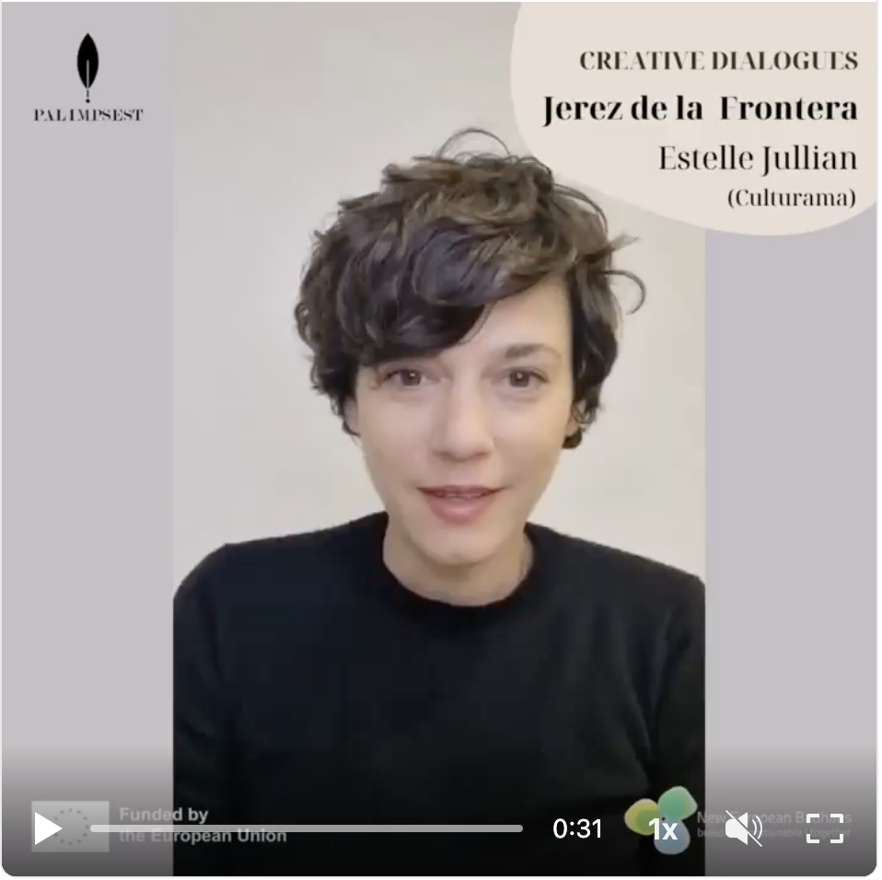
The experiment | Creative dialogues
The Songs by the nearby Earth
I. Bianchi
NMP24
Reggio Calabria, 22/05/2024

Slide 16
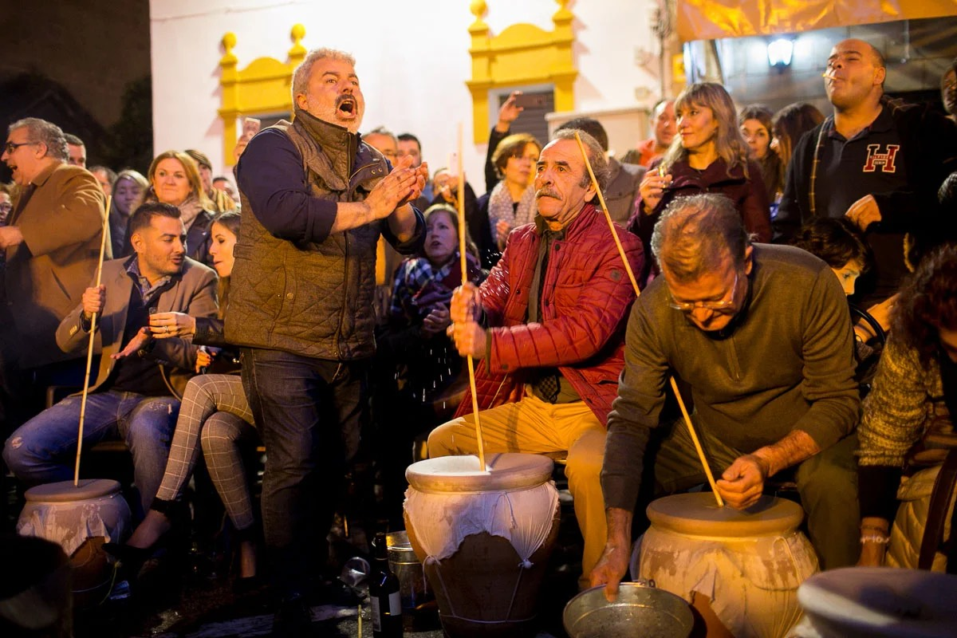
ZAMBOMBA as an OBJECT and a RITUAL

Slide 17
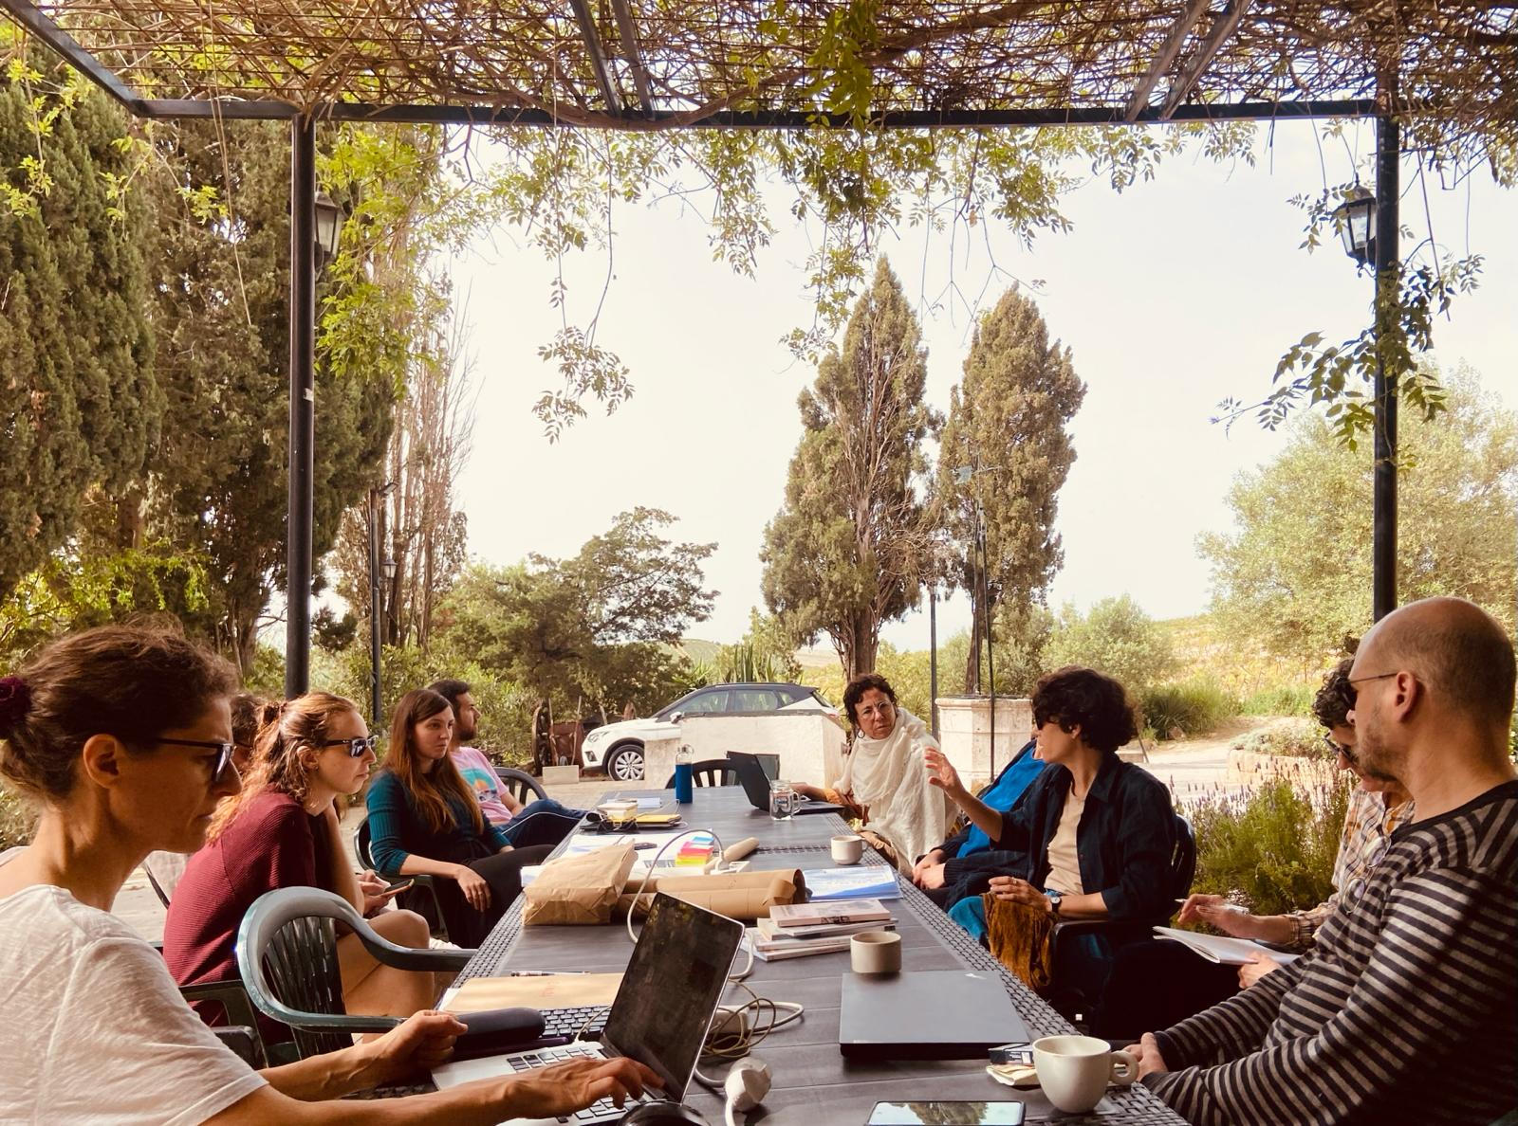
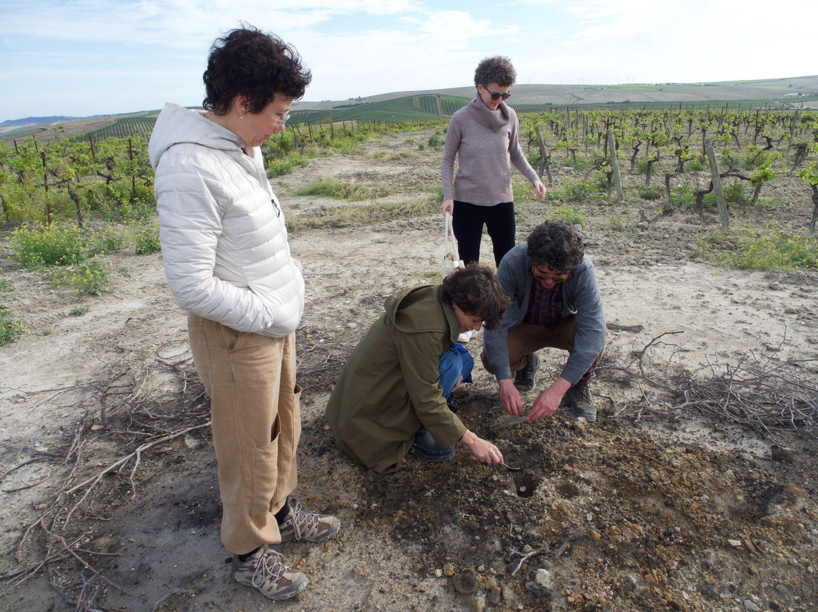
The experiment | RW
Explore the context together and engage with local actors
Refine and further develop the idea through a co-creation process
Start thinking about its “rooting” in the context drafting a prototyping plan
I. Bianchi
NMP24
Reggio Calabria, 22/05/2024

Slide 18
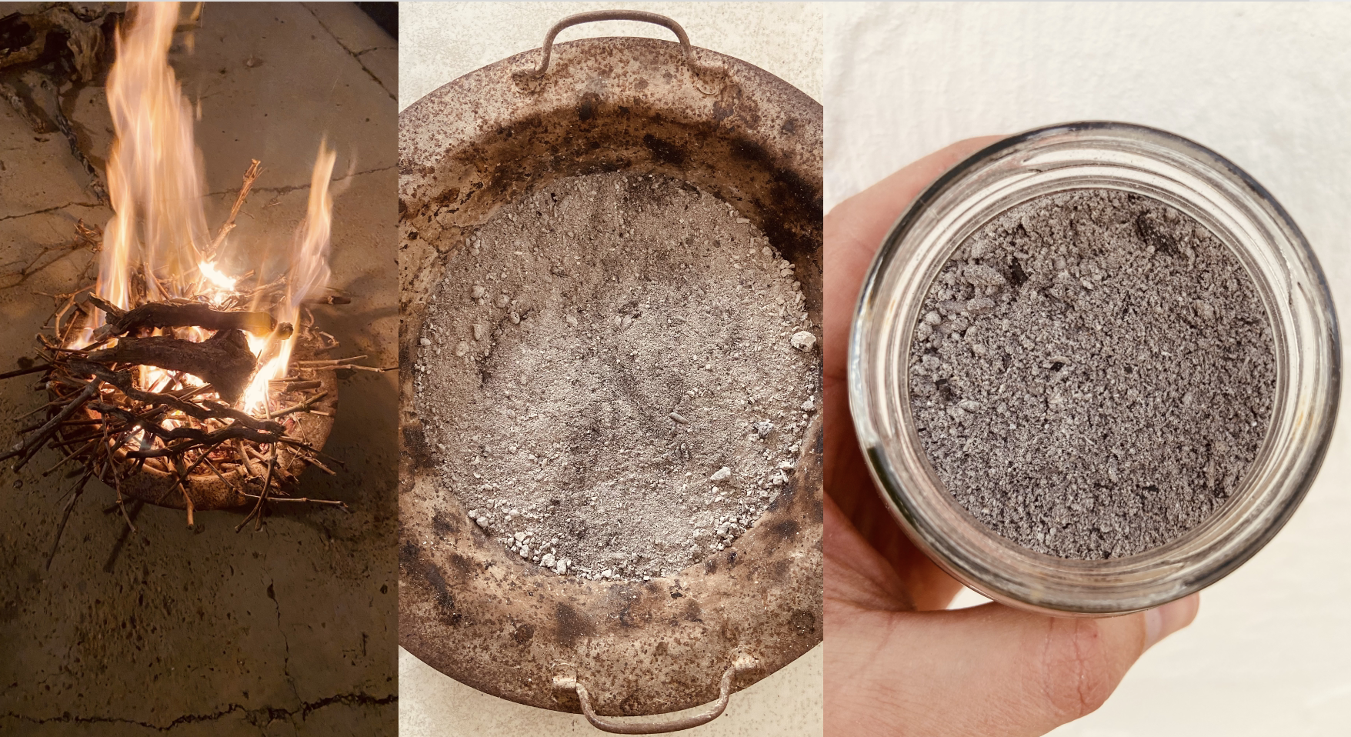
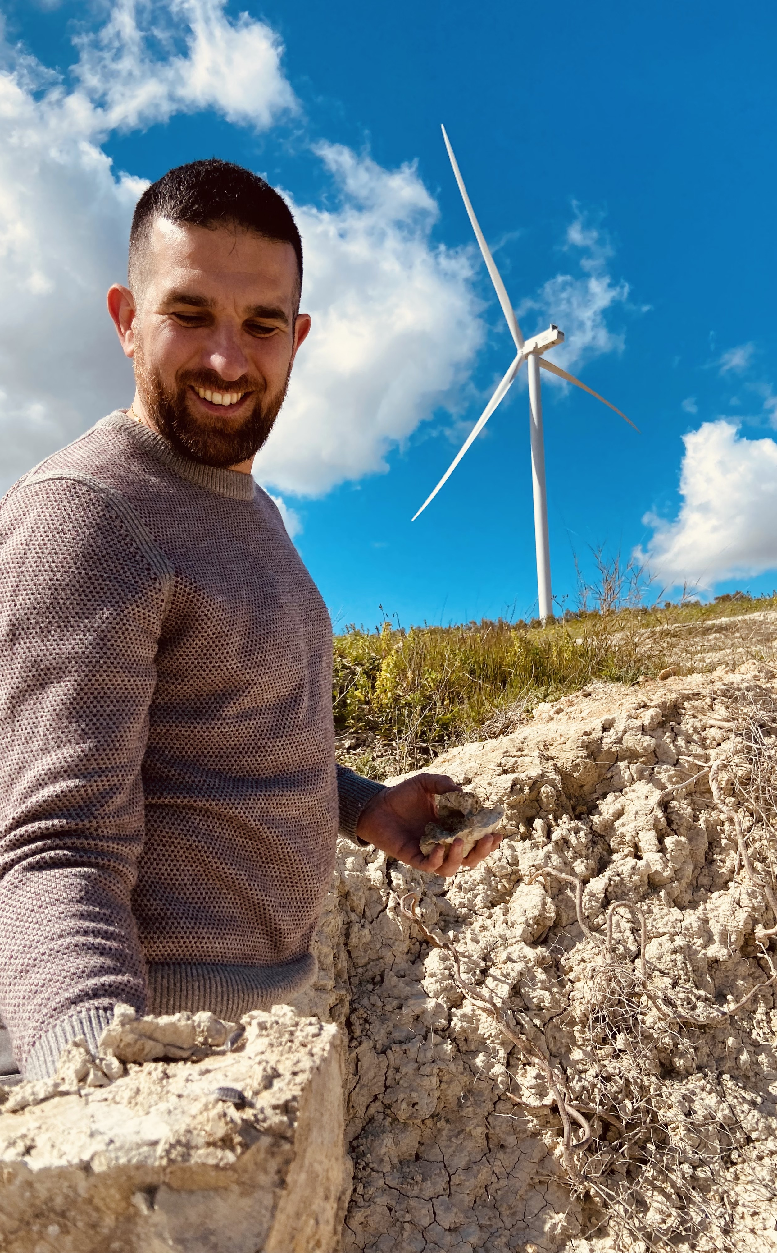
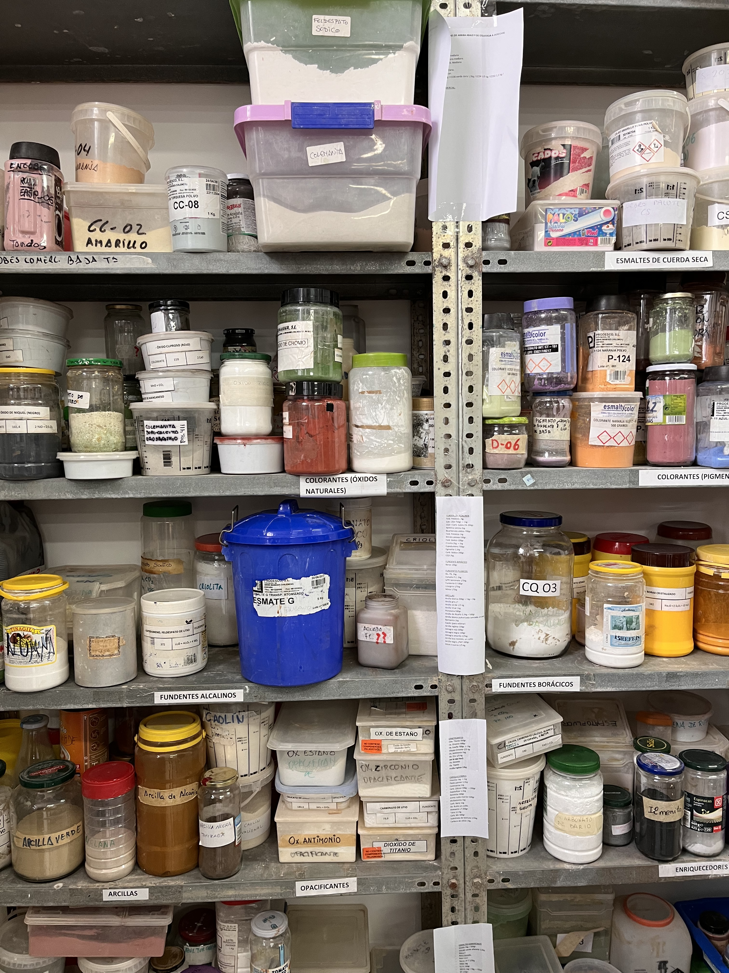
Preliminary insights | I
RECONNECTING TRADITIONAL LANDSCAPE ELEMENTS, LOCAL INTANGIBLE HERITAGE AND THE NEW ENERGY LANDSCAPE THORUGH MATERIALS
(Bioregional approach)
I. Bianchi
NMP24
Reggio Calabria, 22/05/2024

Slide 19
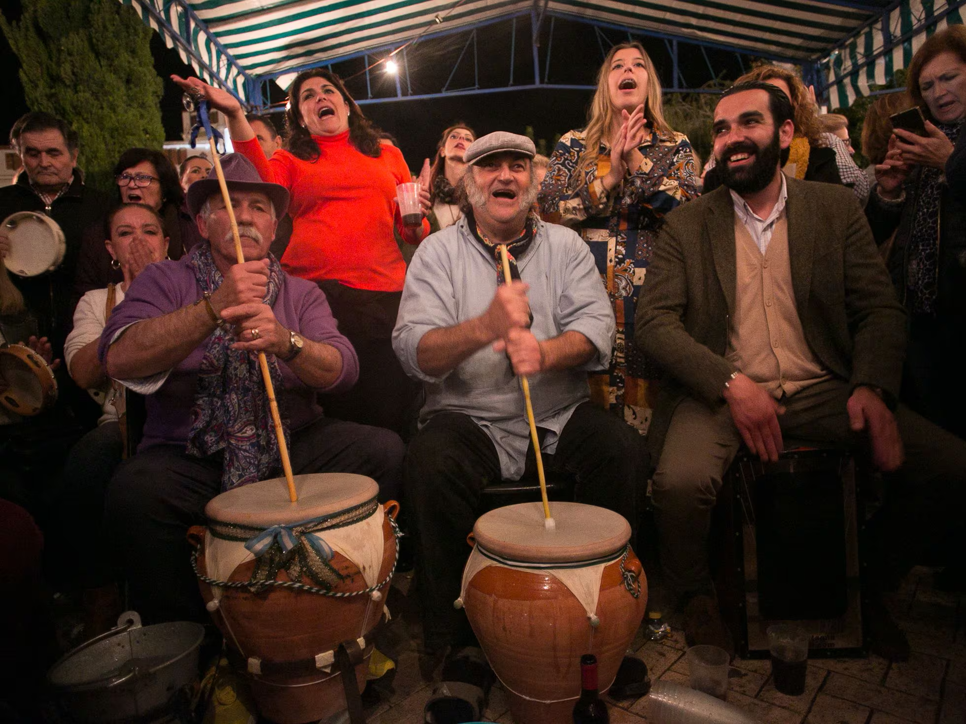
Preliminary insights | II
RECONNECTING TRADITIONAL LANDSCAPE ELEMENTS, LOCAL INTANGIBLE HERITAGE AND THE NEW ENERGY LANDSCAPE THORUGH NARRATIVES
I. Bianchi
NMP24
Reggio Calabria, 22/05/2024

Slide 20
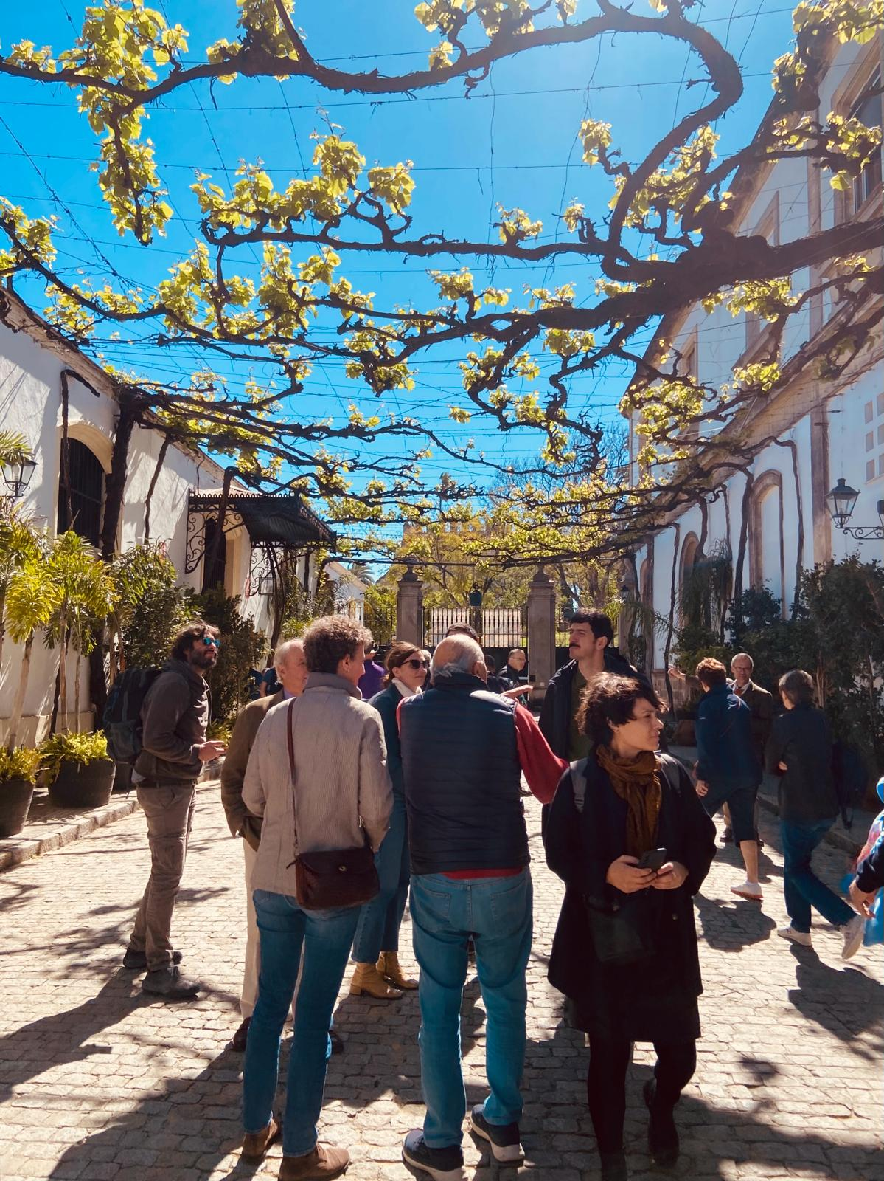
Preliminary insights | III
RECONNECTING TRADITIONAL LANDSCAPE ELEMENTS, LOCAL INTANGIBLE HERITAGE AND THE NEW ENERGY LANDSCAPE THORUGH
NBS
I. Bianchi
NMP24
Reggio Calabria, 22/05/2024

Slide 21
Preliminary reflections
Open possibilities
Not solutions but directions
Extending the boundaries of the debate including practical / material / emotional dimensions
Supporting shared imaginative efforts
Opening small spaces for dialogue among the actors involved
Bridging problem-based and innovation governance (Jenssen et al. 2021, Mazuccato, 2018)
Difficulties
Finding a shared language
Issues of entitlement
I. Bianchi
NMP24
Reggio Calabria, 22/05/2024

Slide 22
Thank you for your attention!
Irene Bianchi irene.bianchi@polimi.it

